Slide 1
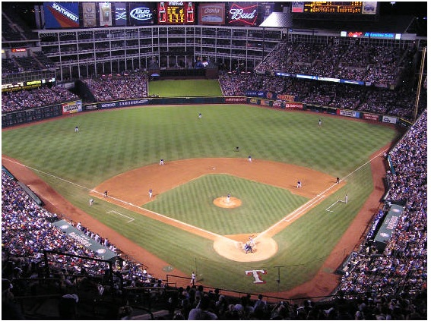
I Can Make a Ballpark Estimate
You don’t want to be OUT IN LEFT FIELD!
You want your answer to BE IN PLAY! Close to the correct answer.

Slide 2
I Can Make a Ballpark Estimate
Remember
When you make a Ballpark Estimate you change the numbers to close but EASIER numbers that you can easily add in your head.
Which is easier to solve mentally?
30 + 50 = or
27 + 54 =

Slide 3
I Can Make a Ballpark Estimate
32 1, 2, 3, or 4 we round down
+47 5, 6, 7, 8, or 9 we round up
30
+50

Slide 4
I Can Make a Ballpark Estimate
Step 1: Change each number to a close but easier number. Step 2: Add the easier numbers together. Step 3: Add the original numbers. Step 4: Does my answer make sense? Compare the numbers.

